Slide 1

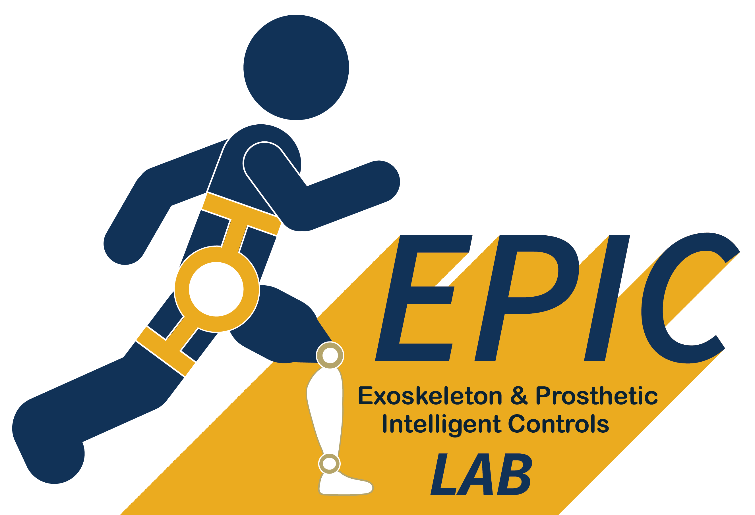

PERSONALIZED EXOSKELETON CONTROL FOR OPTIMIZING GAIT ECONOMY IN STROKE SURVIVORS
Daniel Rodriguez-Jorge, Gregory Sawicki, Aaron Young
August 14th, 2025
American Society of Biomechanics (Pittsburgh, PA)
Advances in Biomechanics with the power of AI & ML
Notes:
Notes:

Slide 2
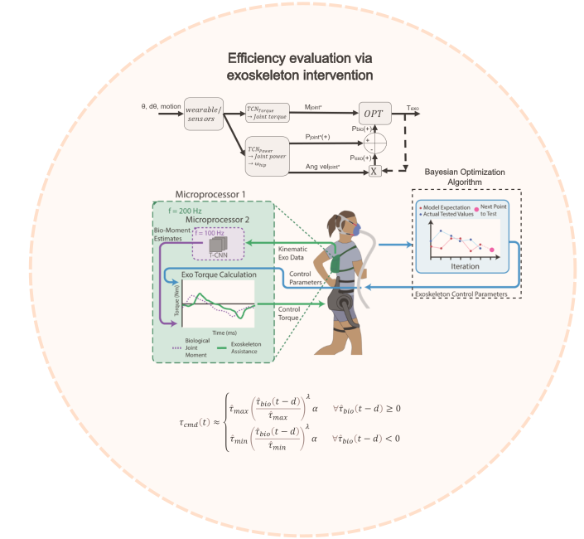
Summary
Introduction
Generalizable exoskeleton control post-stroke using neural networks
Personalized, human-in-the-loop optimization
Preliminary experimental results
Conclusion
Introduction
Generalizable controller
Optimization
Conclusion

Slide 3
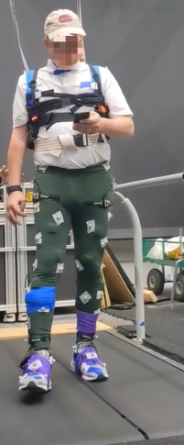
Introduction
Millions with reduced independence, increased metabolic cost, and risk of health complications [1]
Exoskeletons to restore mobility face critical barriers. Limited adaptability to individual gait patterns post-stroke
We want to personalize exoskeleton assistance beyond biotorque for reduced energy cost post-stroke with no metabolic masks
[1] Murray et al. (2007), Reviews in Clinical Gerontology 17(4)
Introduction
Generalizable controller
Optimization
Conclusion

Slide 4
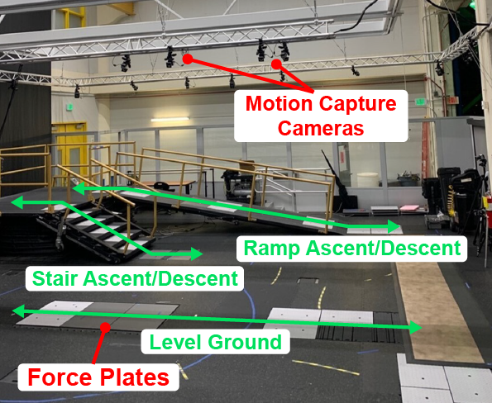
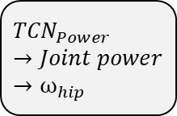

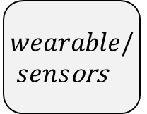
Generalizable exoskeleton control post-stroke using neural networks
Large amounts of data are required for joint torques in clinical populations
Collected stroke data in different tasks, N = 20
Data to train AI models that are generalizable across subjects and tasks
$wearable/sens$ors
$${TCN}_{Torque} →Joint torque$$
θ, dθ, motion
$${TCN}_{Power}→Joint power→ω_{hip}$$
Introduction
Generalizable controller
Optimization
Conclusion

Slide 5
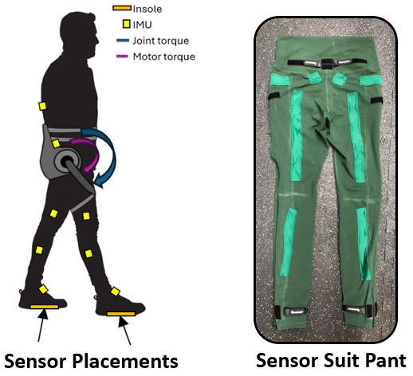
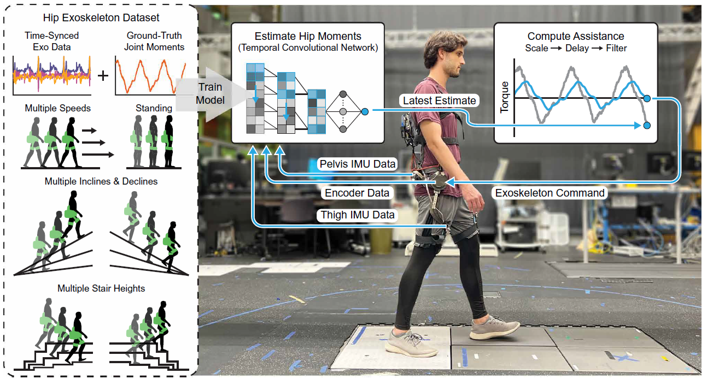
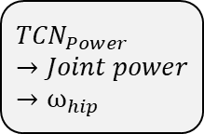


Generalizable exoskeleton control post-stroke using neural networks
Collected data was used to train a Temporal Convolutional Neural Network to estimate total hip moments in real-time using the sensor suit
θ, dθ, motion
$${TCN}_{Torque} →Joint torque$$
$wearable/sens$ors
$${TCN}_{Power}→Joint power→ω_{hip}$$
[2] Molinaro et al. (2024), Science Robotics 9
Introduction
Generalizable controller
Optimization
Conclusion
Notes:
A neural network is a computational model made of layers of interconnected “neurons” that learn to detect patterns in data. Each neuron applies a simple mathematical transformation, and by stacking many layers, the network can represent complex relationships—enabling tasks like prediction, classification, and generation.
A Temporal Convolutional Network (TCN) is a convolutional neural network architecture for sequence modeling that replaces recurrence with causal, dilated 1-D convolutions. It ensures predictions at time t depend only on the present and past (causality), and uses dilation to capture long-range dependencies efficiently.

Slide 6
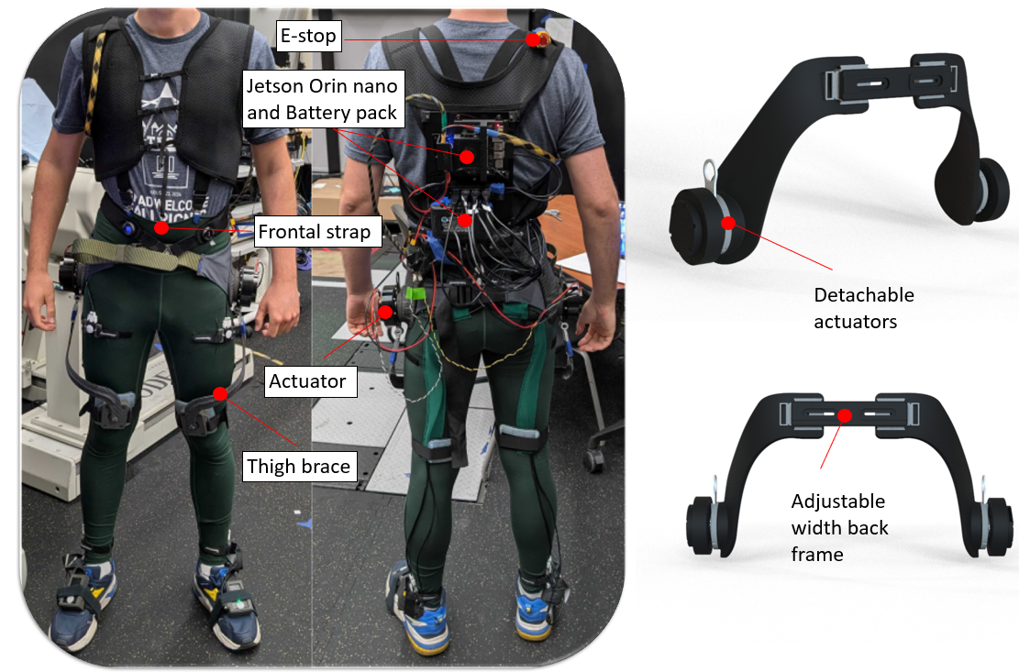



Generalizable exoskeleton control post-stroke using neural networks
Modular robotic hip exoskeleton for stroke patients, device-agnostic sensor layout
Using neural networks to estimate joint torque as in [2]
Reduced metabolic cost vs no exoskeleton with device-specific training data [3]
θ, dθ, motion
$wearable/sens$ors
Mjoint*
Texo
$${TCN}_{1} →Joint torque$$
$$Filter, delay$$
[2] Molinaro et al. (2024), Science Robotics 9
[3] Molinaro et al. (2024), Nature 635
Introduction
Generalizable controller
Optimization
Conclusion
Notes:
How we remove masks with cool Ryan paper, and nature paper. Cite Greg relationship between mech work and metabolic work.

Slide 7
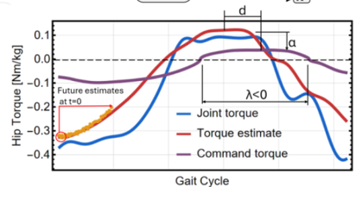
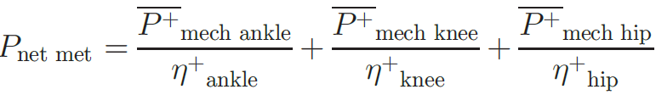
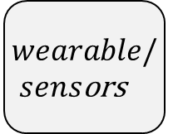
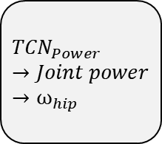



Personalized, human-in-the-loop optimization
Optimized for reduced mobility cost without masks!
Added shaping for wide spectrum of assistance profiles
θ, dθ, motion
$wearable/sens$ors
Mjoint*
$$OPT$$
Texo
$${TCN}_{Torque} →Joint torque$$
Pbio(+)
Pjoint*(+)
+
$${TCN}_{Power}→Joint power→ω_{hip}$$
-
Pexo(+)
Ang veljoint*
$$X$$
[4] Sawicki et al. (2009), Exercise and Sport Sciences Reviews 37(3)
Introduction
Generalizable controller
Optimization
Conclusion

Slide 8
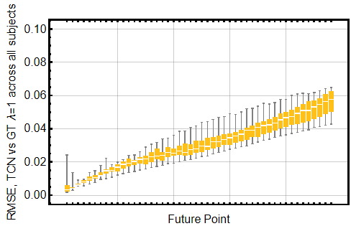


Personalized, human-in-the-loop optimization
Label | RMSE, Stroke | R2, Stroke
Hip Power | 0.18 | 0.58
Hip Angular Velocity | 0.37 | 0.88
Knee Power | 0.20 | 0.54
Ankle Power | 0.23 | 0.76
Hip Torque (current) | 0.18 | 0.65
Mjoint*
$$OPT$$
Texo
Pbio(+)
+
-
Pexo(+)
$$X$$
Ang veljoint*
Introduction
Generalizable controller
Optimization
Conclusion

Slide 9
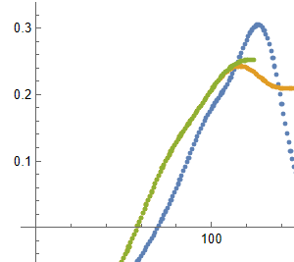
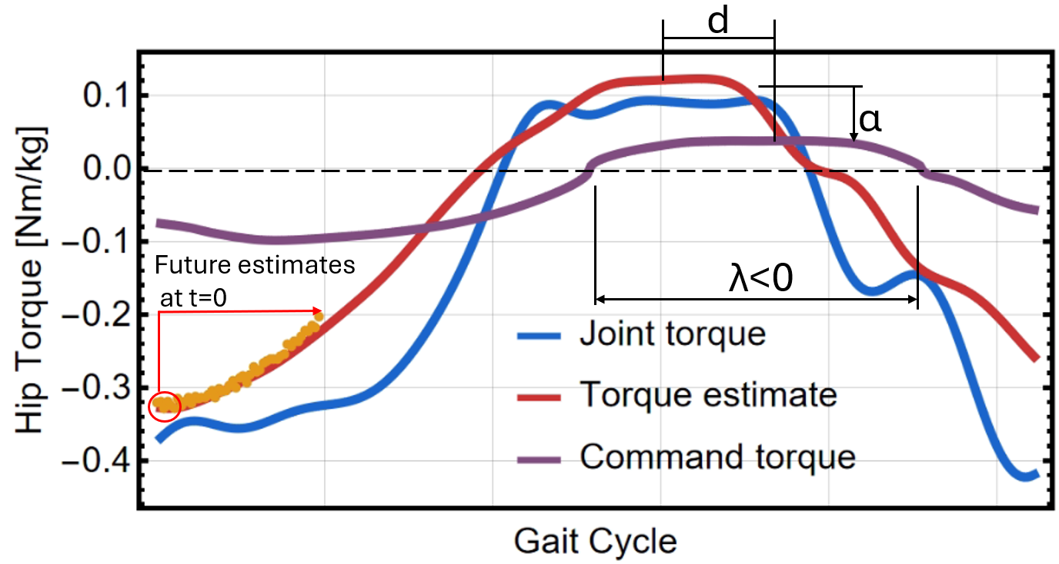
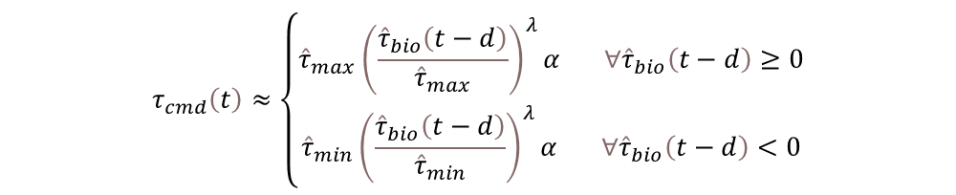


Personalized, human-in-the-loop optimization
Our proposed 3 parameters, scale, delay, and now shape, opening up beyond biotorque
$$τ_{cmd}\left(t\right)≈\left\{\begin{aligned}{\hat{τ}}_{max}{\left(\frac{{\hat{τ}}_{bio}\left(t−d\right)}{{\hat{τ}}_{max}}\right)}^{λ}α{ ∀\hat{τ}}_{bio}\left(t−d\right)≥0 \\ {\hat{τ}}_{min}{\left(\frac{{\hat{τ}}_{bio}\left(t−d\right)}{{\hat{τ}}_{min}}\right)}^{λ}α{ ∀\hat{τ}}_{bio}\left(t−d\right)<0\end{aligned}\right.$$
Mjoint*
$$OPT$$
Texo
Pbio(+)
Pjoint*(+)
+
-
Pexo(+)
$$X$$
Ang veljoint*
Introduction
Generalizable controller
Optimization
Conclusion

Slide 10
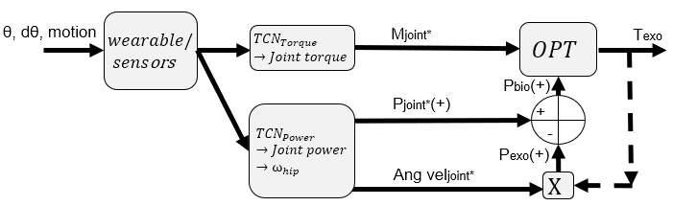
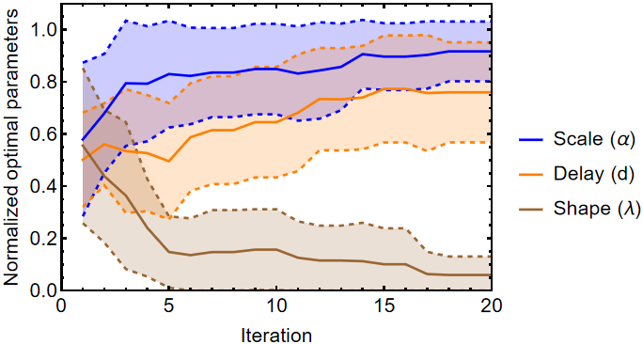
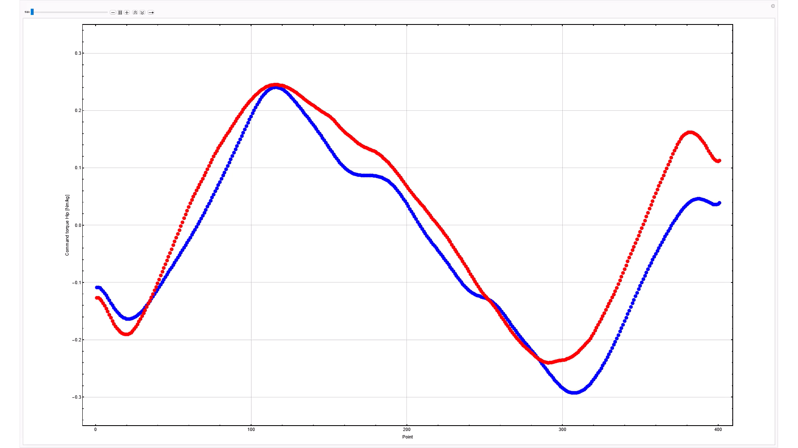
Preliminary experimental results
OFFLINE: We are assuming knee and ankle power are unaltered. Same kinematics regardless of profile – just walking
High scales and low shapes are preferred
120-180ms as expected, [2]
[2] Molinaro et al. (2024), Science Robotics 9

Slide 11
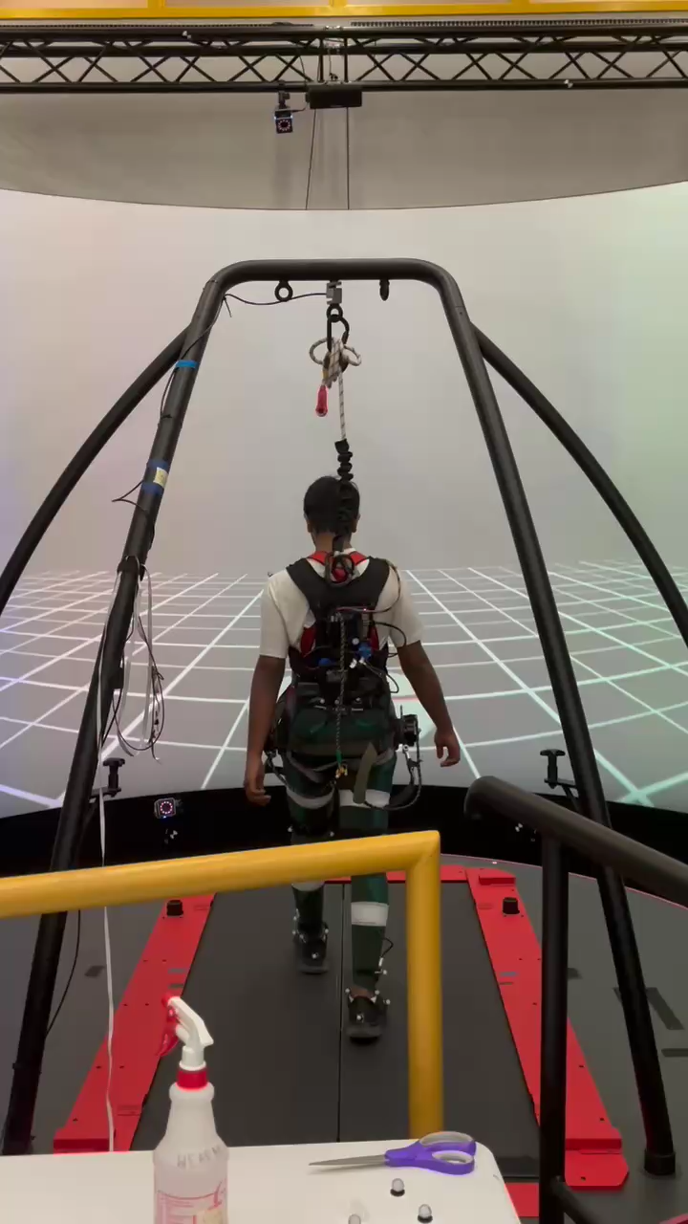
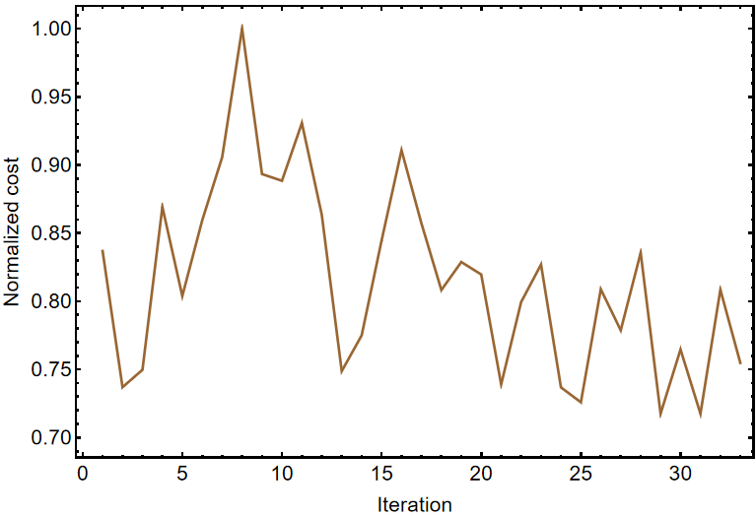
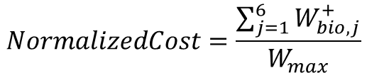
Preliminary experimental results
$$NormalizedCost=\frac{\sum_{j=1}^{6}{W_{bio,j}^{+}}}{W_{max}}$$
First AB pilot test. 14.2% reduction in estimated power vs vanilla (30% scale, no delay, λ=1)
N = 1, AB
Best parameters: scale ≈ 20%, add. delay ≈ 25ms, λ ≈ 1.2
Unequal results between legs in AB, potentially lack of convergence and stroke-only TCNs
-14.2%
*Each iteration is 1 minute long
Introduction
Generalizable controller
Optimization
Conclusion

Slide 12
Conclusion
Developed a user-state-trained controller and Bayesian optimizer for hip exoskeleton assistance for stroke with N=20 TCNs
Developed a task-agnostic, biotorque shaping paradigm for reduced energy cost without metabolic masks required
Conducted successful offline and pilot experiments to identify optimal torque parameters
Ready to launch final experiments in stroke populations, targeting personalized assistance profiles and evaluating metabolic and muscle activation improvements
Introduction
Generalizable controller
Optimization
Conclusion

Slide 13
PERSONALIZED EXOSKELETON CONTROL FOR OPTIMIZING GAIT ECONOMY IN STROKE SURVIVORS
Daniel Rodriguez-Jorge, Gregory Sawicki, Aaron Young
August 14th, 2025
American Society of Biomechanics (Pittsburgh, PA)
Advances in Biomechanics with the power of AI & ML

